Slide 1
Lead Schools
Tees valley Music Hub

Slide 2
Does your school………………………..?
Exemplify high quality music provision and teaching
Show commitment to curriculum delivery with significant timetabled lessons, co-curricular opportunities, inclusive provision and CPD for staff
Have the willingness to support other schools in your area
Advocate best practice and the work of the Music Hub
If it’s a “Yes”……………….
Please note we appreciate that some of this may be work in progress

Slide 3
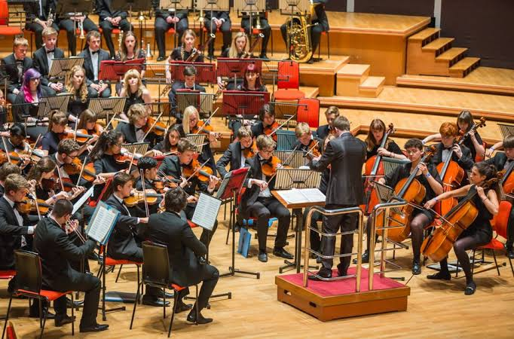
Tees Valley Music Hub would like to invite you to apply to become LEAD SCHOOL or SETTING for your area.

Slide 4
By April 2025 each Music Hub must appoint LEAD SCHOOLS in each area.
This can be at least one from each of the primary, secondary and SEND settings.

Slide 5
What will LEAD SCHOOLS do?
Lead Schools will play a strategic role in the delivery of music in the areas by working with the Hub Lead Organisation on:
LEARNING NETWORKS
CPD COURSES
MENTORING
PEER SUPPORT ACTIVITY
COLLABORATIVE MUSIC PROJECTS
BEST PRACTICE & RESOURCE SHARING

Slide 6
How many LEAD SCHOOLS?
We will appoint at least one primary and one secondary school from each area:
Hartlepool
Middlesbrough
Redcar & Cleveland
Stockton on Tees
We aspire to appoint Lead Settings for SEND, EYFS, FE/HE and Alternative Provision settings when and where possible.

Slide 7
Timeline?
Applications submitted by Monday 10th March 2025
Schools shortlisted by Monday 24th March 2025
Shortlisted schools visited during April 2025
Lead Schools/Settings informed by Wednesday 30th April 2025

Slide 8
Queries? Contact…
Susan Robertson, Service Manager
tvsrobertson@tvms.org.uk
Jeff Sawdon, Assistant Manager
tvjsawdon@tvms.org.uk
Apply via link below…
Lead Schools Application Form

